Slide 1
Screenshots to Basics Exercises(Html &CSS exercises)
Prepared By:
Ishraq AlDagamseh
ID: C-25-616

Slide 2
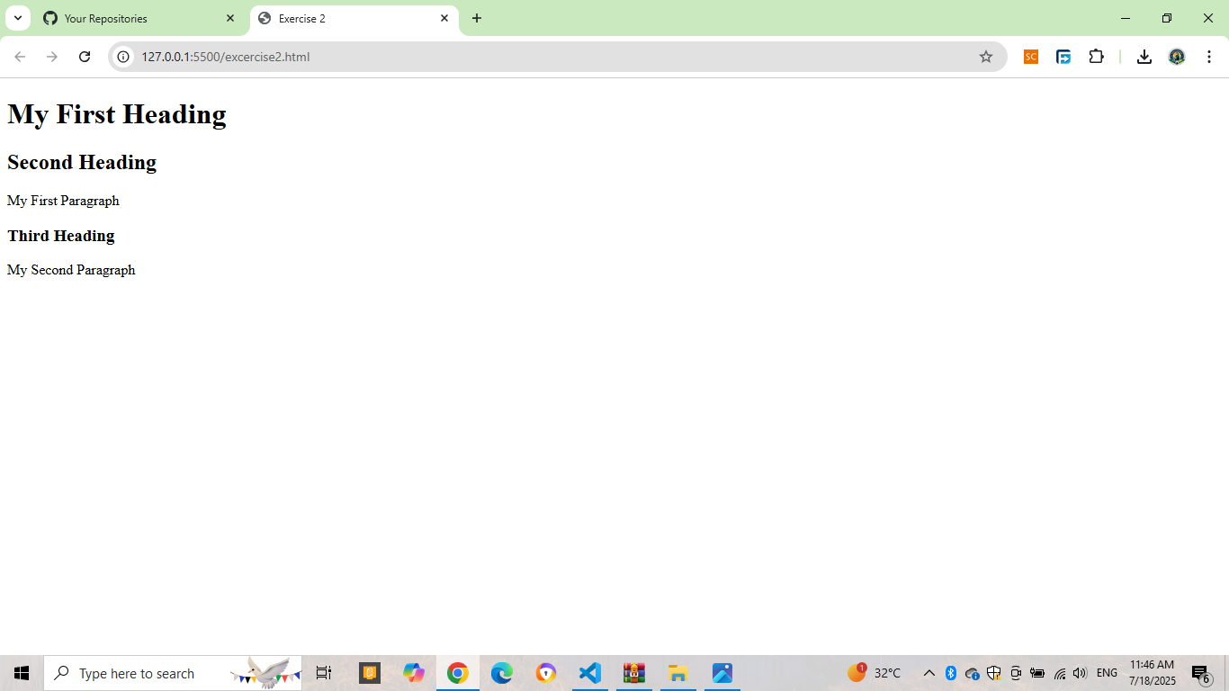
Exercises2

Slide 3
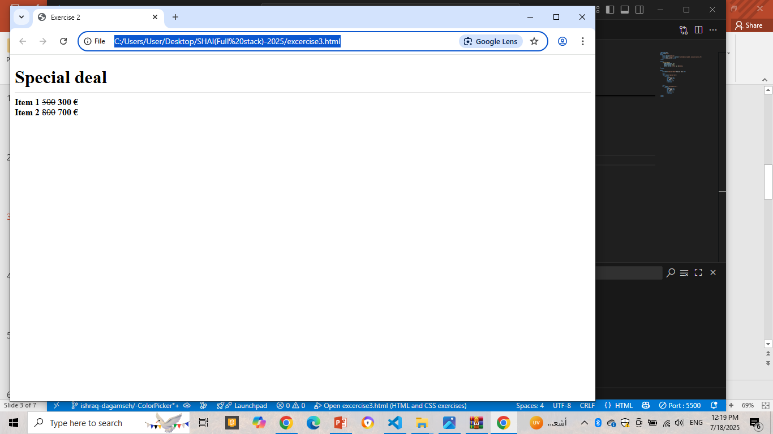
Exercise 3

Slide 4
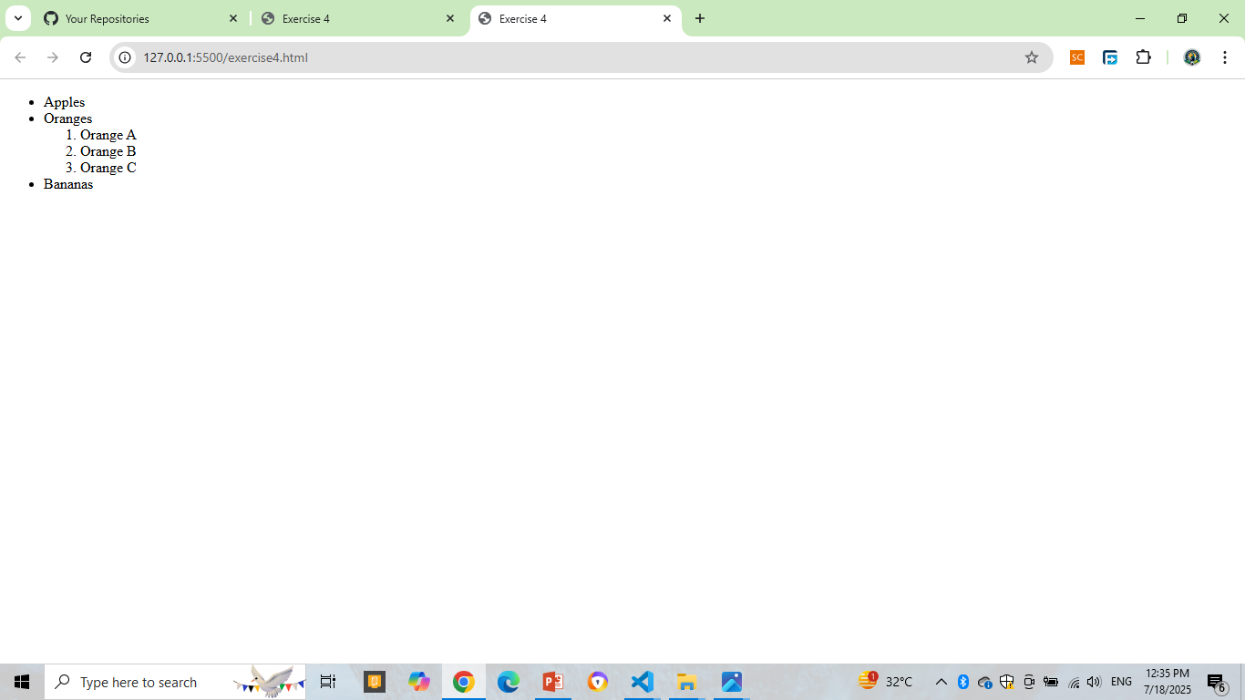
Exercise 4

Slide 5
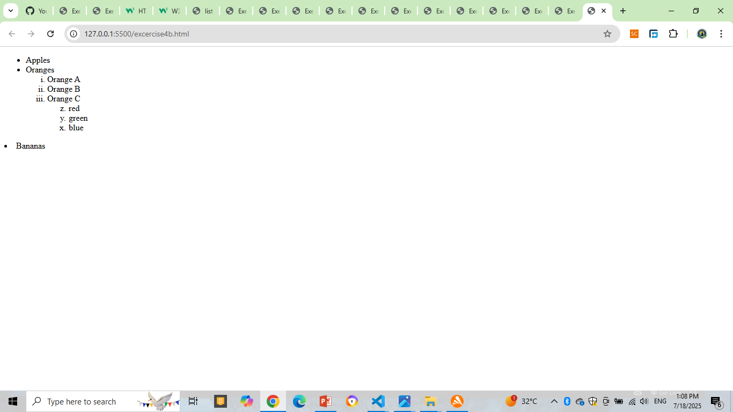
Exercise 4b

Slide 6
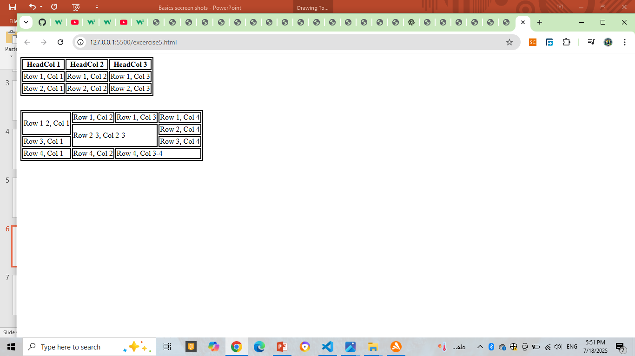
Exercise 5

Slide 7
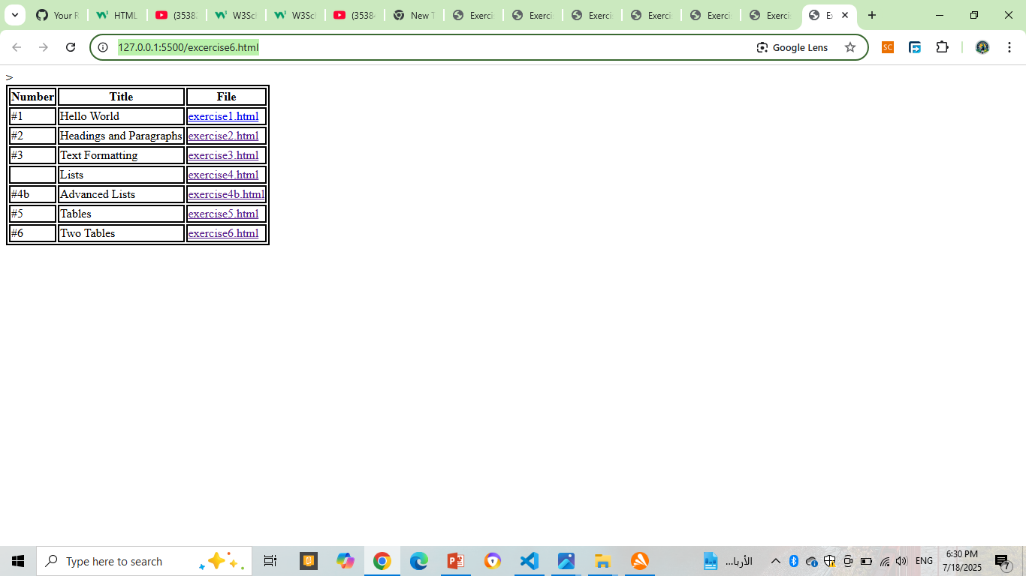
Exercise 6

Slide 8
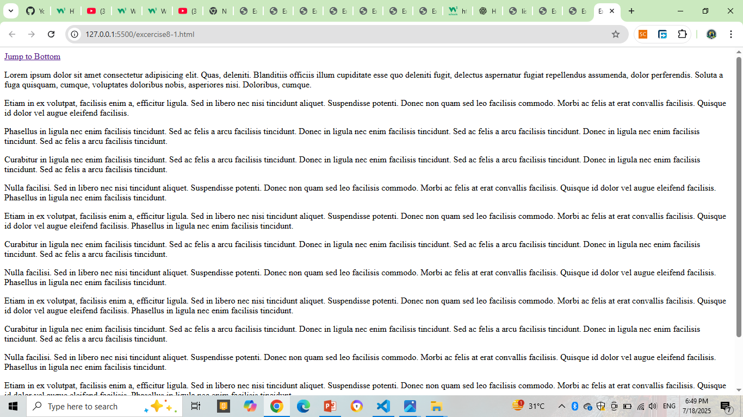
Exercise 8-1

Slide 9
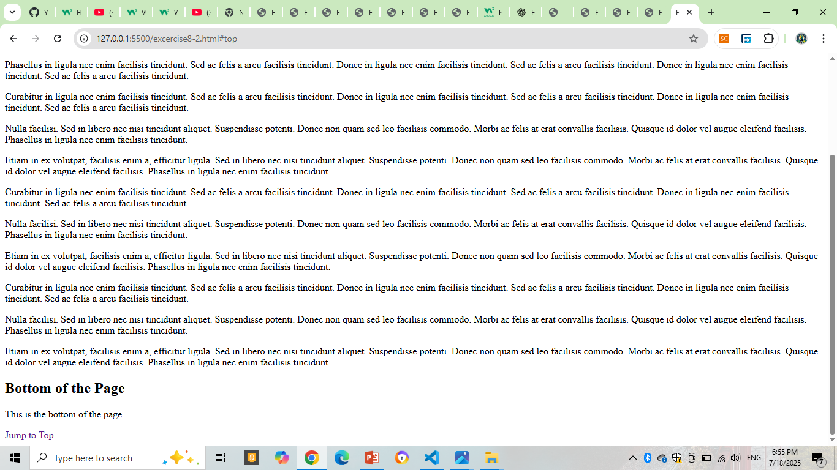
Exercise 8-b

Slide 10
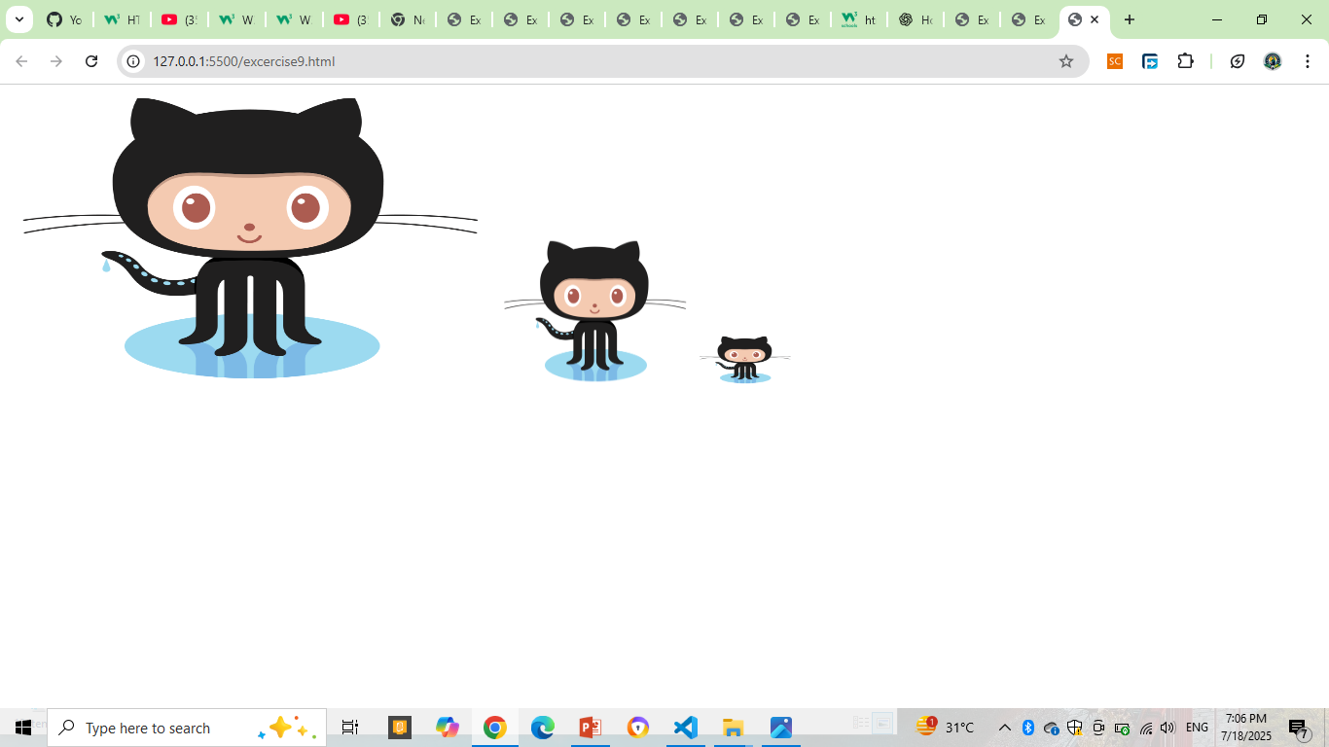
Exercise 9

Slide 11
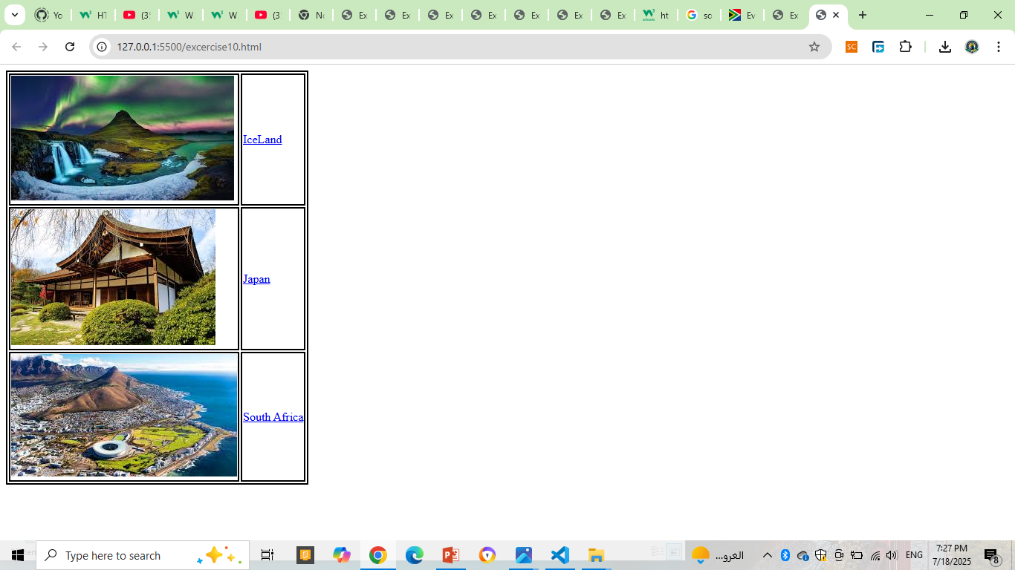
Exercise 10

Slide 12
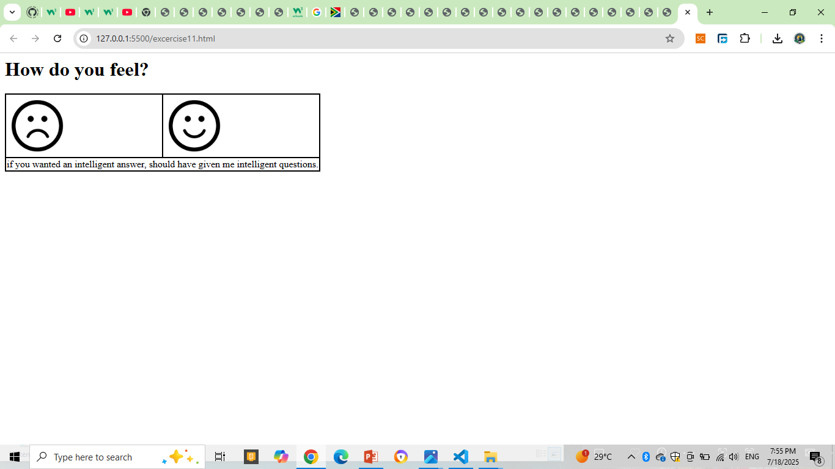
Exercise 11

Slide 13
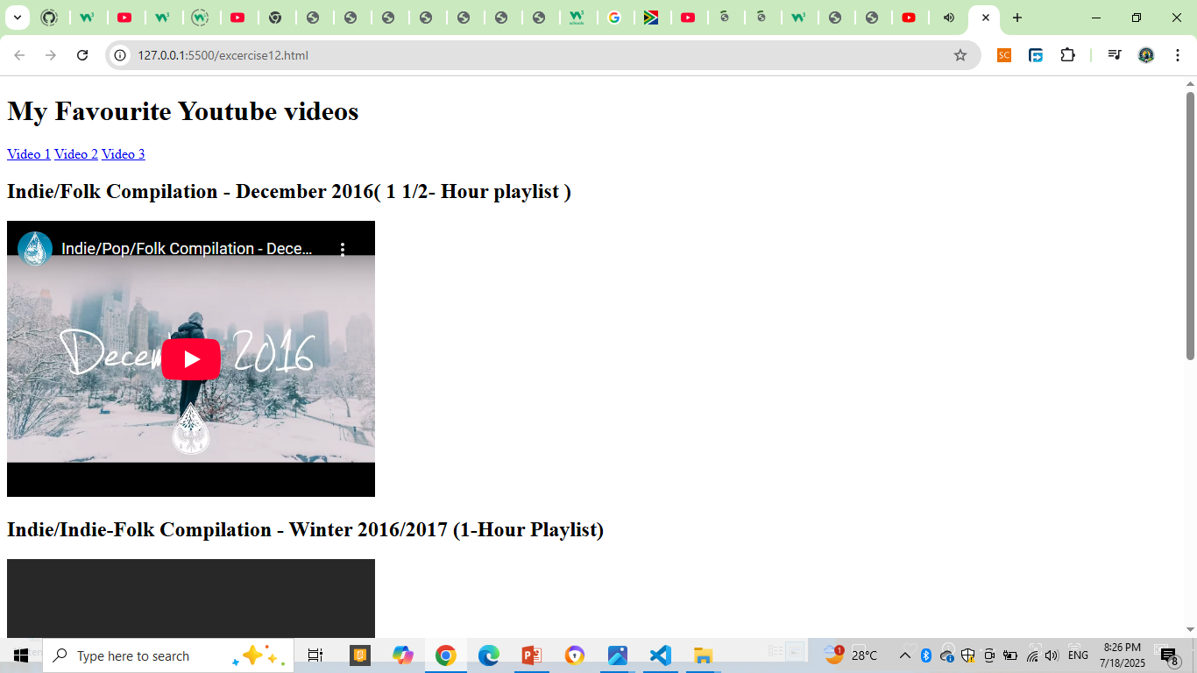
Exercise 12

